Slide 1
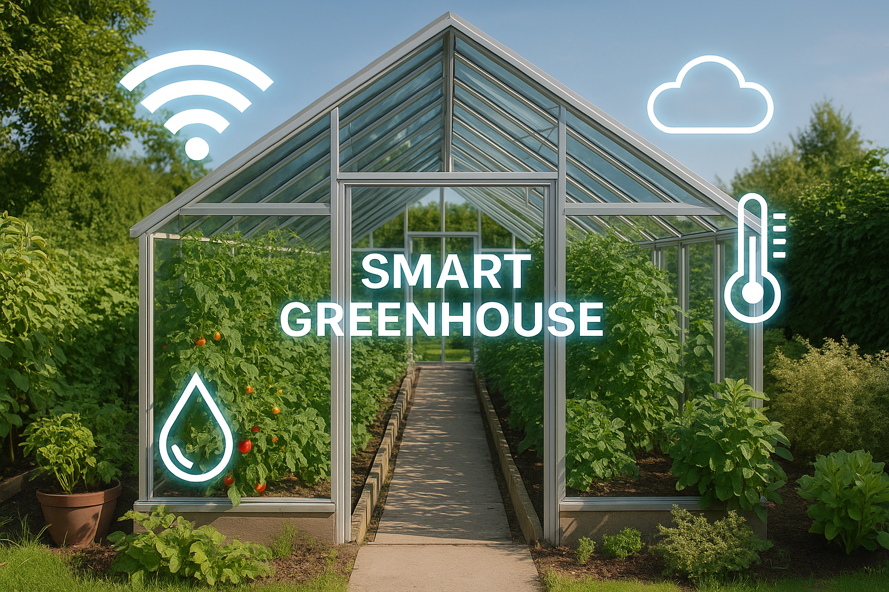
Smart IOT – BASED Irrigation System with ESP8266
Team members:
Raghad AL-Lahham
Rama AL-Momani
Tasneem AL-Omari
Feras AL-Momani
Project Supervisor Dr.Raed AL-Khatib

Slide 2

The "Smart IOT – BASED Irrigation System " project combines the Internet of Things (IoT), artificial intelligence (AI), and a modern user interface to build a smart and sustainable agricultural solution.
Future Benefits:
Reduced water consumption
Increased crop productivity
Reduced manual intervention
Scalability and connectivity to global agricultural platforms

Slide 3

Project Objectives
Measuring soil moisture
Measuring temperature and humidity
Measuring water level in the tank
Automatic or manual pump control
Sending and receiving commands via MQTT

Slide 4

THE SENSIOR USED
ESP8266
Ultrasonic HC-SR04 to measure water level in the tank
Soil Moisture sensior
DHT11 for air temperature and humidity
Relay for pump control
16x2 I2C LCD display for readings

Slide 5
Network Connection
Connect to a Wi-Fi network
Use MQTT over TLS for a secure connection
Communicate with HiveMQ Cloud
Exchange data in an encrypted and secure manner
Soil Moisture Sensor:
Measures soil moisture
The higher the moisture content, the less watering is required
Values ​​between:
0% = Dry soil
100% = Saturated soil

Slide 6
Ultrasonic Water Sensor
Measures the distance between the sensor and the water surface.
The greater the distance, the lower the water level.
The reading is converted to a percentage of the fill level.
Pump Control
Manual Operation via:
MQTT
REST API
Possibility of adding automatic operation later.
Pump status is displayed on the screen and sent to the server.

Slide 7
Data Display on Screen
LCD screen displays every 2 seconds:
Soil Moisture
Temperature
Water Level
Pump Status
OTA Update
Remote code update without a USB cable
Progress displayed on screen during update
Password protected for security

Slide 8
(Back-end Architecture):
Technologies Used:
FastAPI for creating a REST API
MQTT + TLS for secure communication with devices
MongoDB Atlas for storing sensor data
Paho MQTT and asyncio for synchronous message processing
Server Functions:
Receive sensor data from the ESP8266 via MQTT
Automatically store data in MongoDB
Available APIs for:
Device status
Read real-time and historical data
Pump control
AI analysis for smart irrigation

Slide 9
(AI Integration)
Sending sensor data (humidity, temperature, water, etc.) to the AI.
Determines whether the pump needs to be turned on or off based on smart rules:
Low humidity below 30 = Turn on the pump.
High humidity above 30 = Turn off the pump.
Output:
AI returns JSON containing:
json
{"pump": true, "reasoning": "Soil is dry and water is sufficient."}
API includes:
/devices/{id}/ai-decision ← To display the AI ​​decision
/devices/{id}/analyze ← To force the AI ​​to analyze again

Slide 10
Smart Irrigation Dashboard (Frontend Architecture)
Technologies Used:
React.js: For building a fast and interactive interface
Tailwind CSS: For flexible and responsive design that supports Dark Mode
Hooks: Such as useEffect and useState for managing state and live data.
Main functions within the interface:
Devices Sidebar:
Displays connected devices (using useDevices)
Updates automatically every 10 seconds
Details of the selected device:
Moisture
Temperature

Slide 11
Artificial Intelligence Irrigation Analysis (AI Decision)
When you click the "Get AI Decision" button:
Sensor data (Moisture, Temp, Humidity, Water Level) is sent to the backend API.
The API analyzes the data using Google Gemini AI.
An intelligent irrigation decision is returned in JSON format:
pump: true/false
reasoning: "The scientific explanation for the decision“

Slide 12
Water Level
Pump State: Pump status (ON/OFF)
Control the pump with the push of a button
Historical data fetching (Telemetry):
Table of the 5 most recent readings
Displays values ​​and time in a beautiful format
Uses the date-fns library for time formatting
Automatic polling: Device data fetched every 10 seconds using setInterval

Slide 13
(Decision UI)
Results are displayed visually:
Decision: Pump ON / OFF
Reasoning: A simple explanation of the reason (e.g., "Low humidity, water available")
Background color changes automatically:
🟢 Green if the decision is ON
🔴 Red if the decision is OFF
Manual Pump Control
An interactive ON/OFF button allows the user to control the pump.
The command is sent to the server via controlPump() via the API.
The status is then updated directly on the interface.

Slide 14
Future Plan 🔧 Scalability Expand system to support multiple greenhouses or farms. Cloud-based architecture for centralized data handling. Optimize AI model to handle large-scale sensor inputs. 📣 Marketing Strategy Target eco-conscious farmers and agri-tech startups. Launch awareness campaigns through social media. Offer free demos or pilot programs for early adopters. 🚀 Future Enhancements Integrate weather prediction APIs for smarter irrigation. Mobile app for real-time monitoring and control. Add AI-based crop disease detection features.

Slide 15
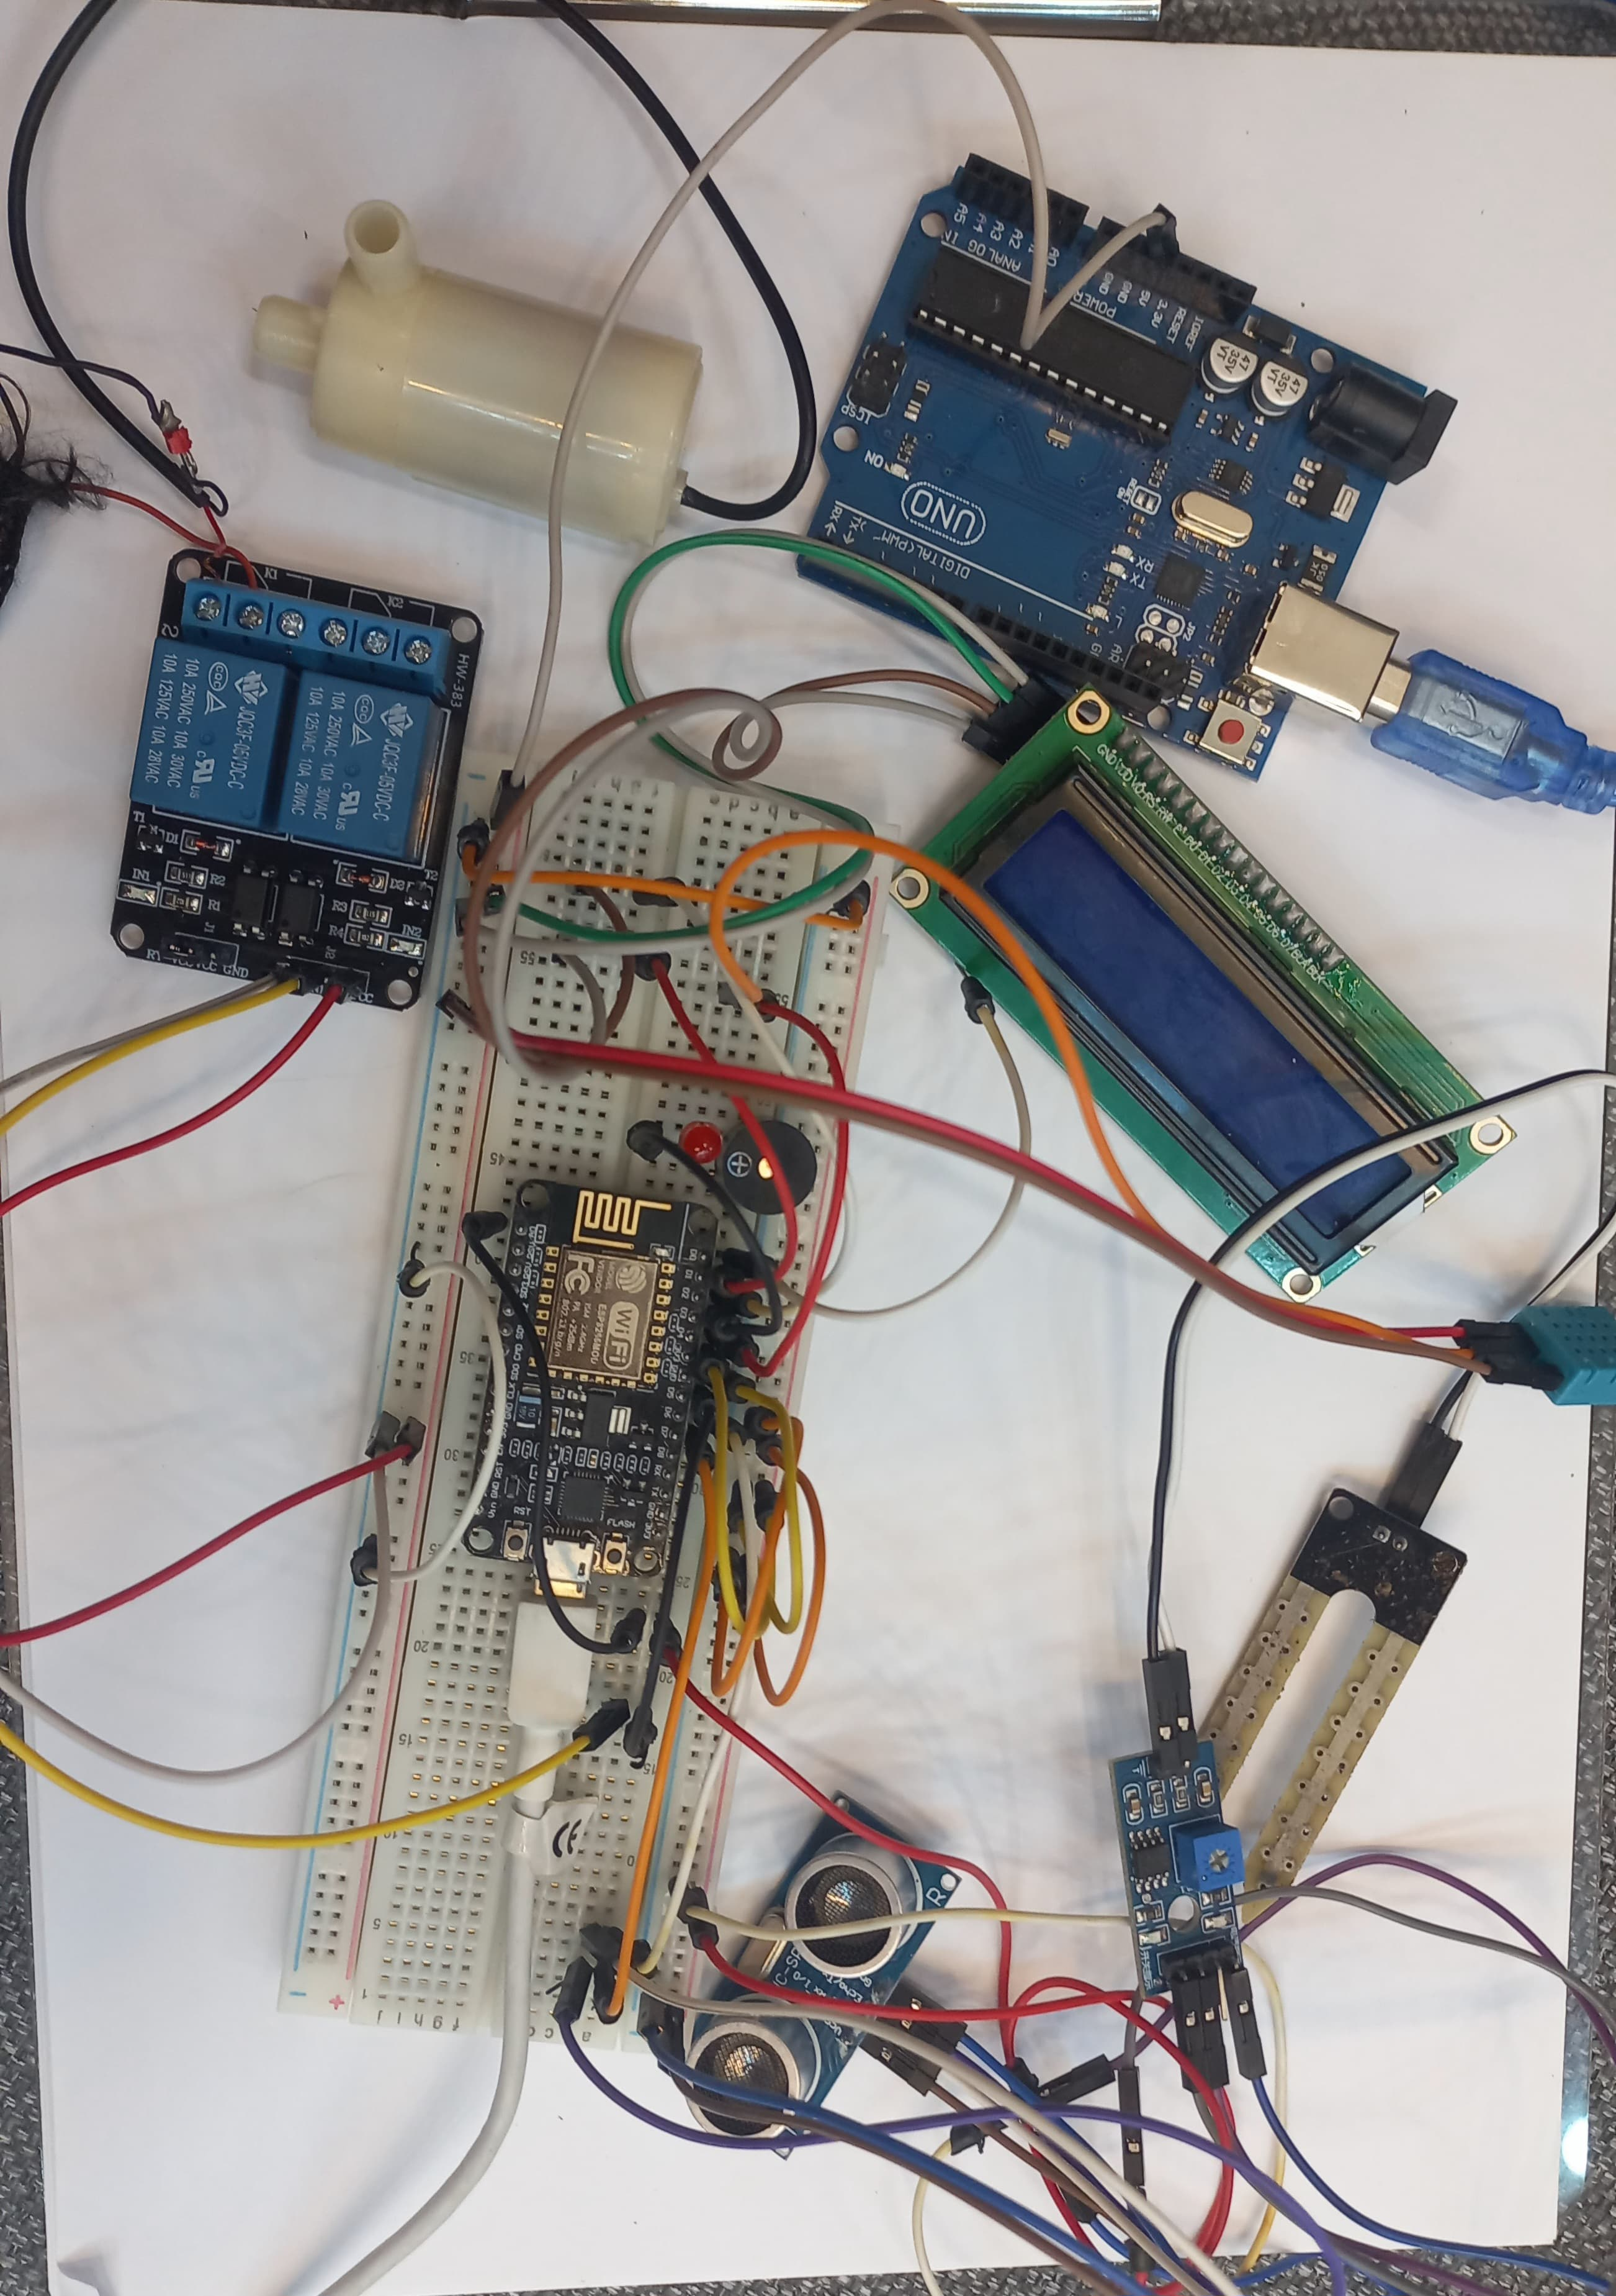
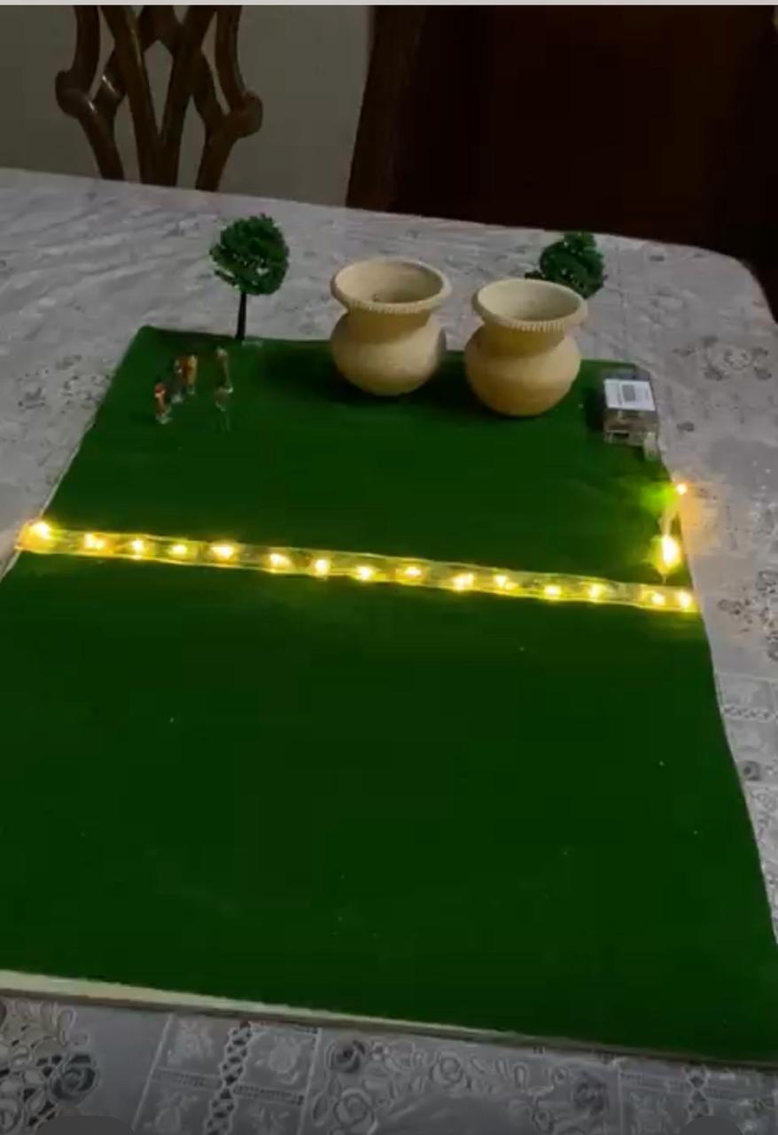
THE END Thanks for LISTENING.

